Slide 1
Momento
Background, problem & Solutioin

Slide 2


Causes of depression
Stress
Work
study

Slide 3

Consequences of depression
Reduced efficiency in work
Reduced social interaction
suicide

Slide 4
Prevalence of depression
6.3% of the population in Singapore
27 suicides due to depression in 2016
submitted for debate in Singapore parliament

Slide 5
Problem
System in place
Samaritans of Singapore (SOS)
Institute of mental health
Singapore psychiatric association
Lack of depression detection method

Slide 6
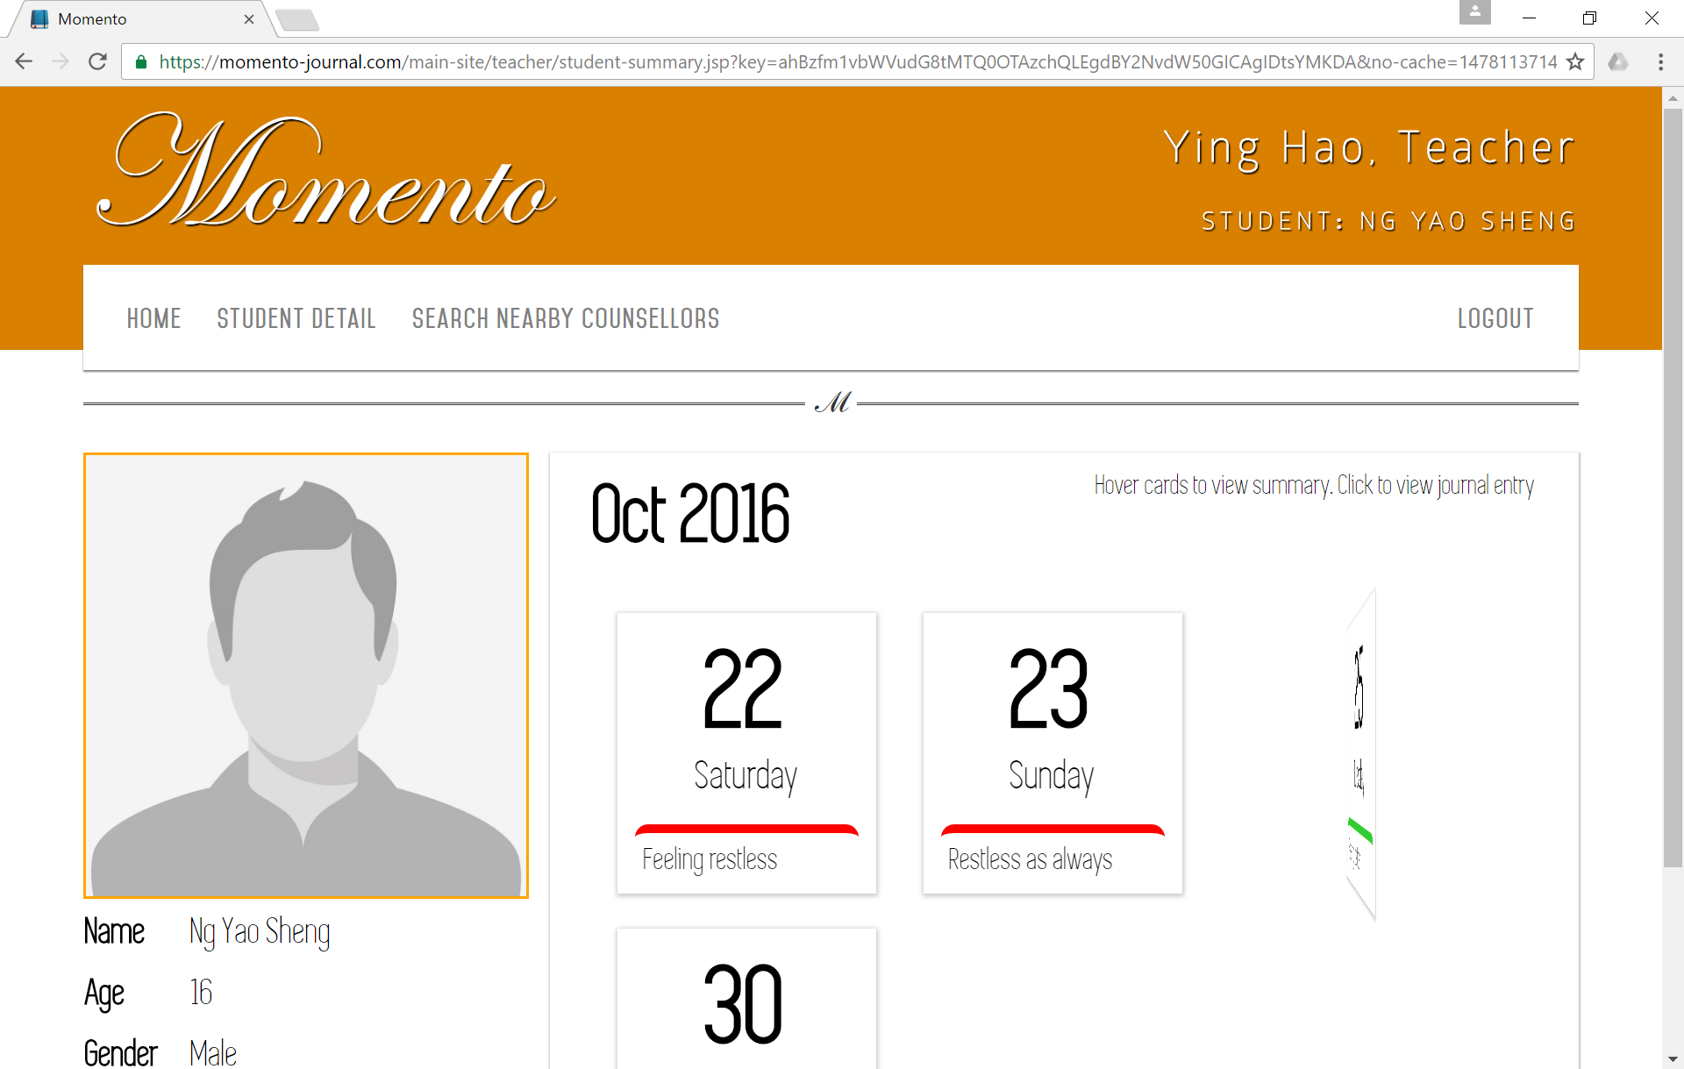
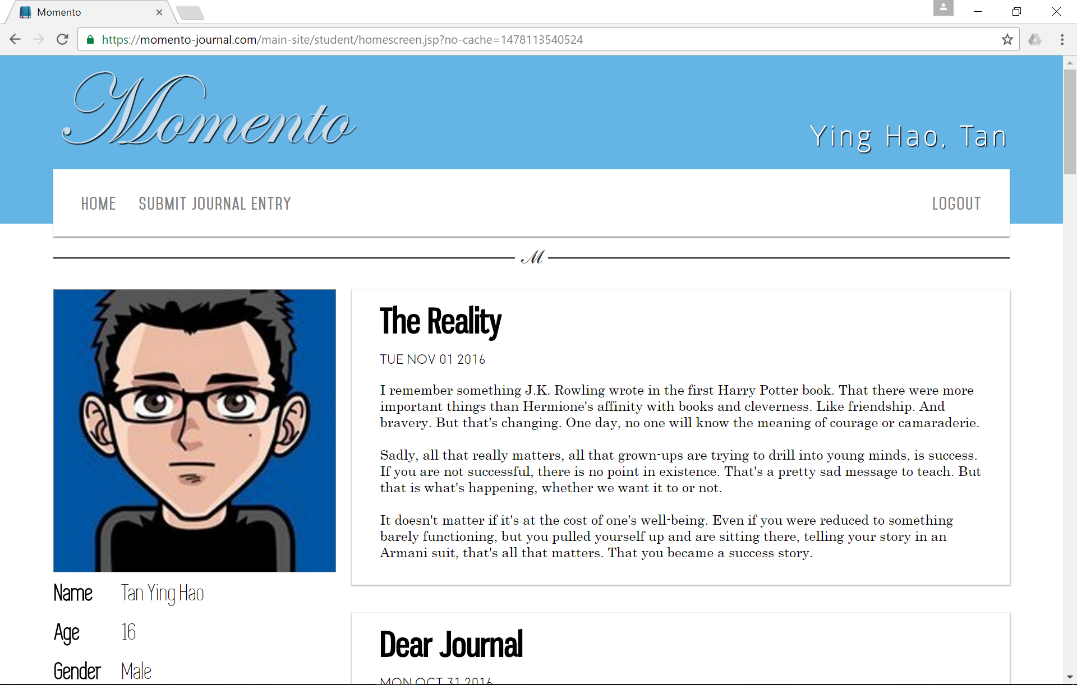
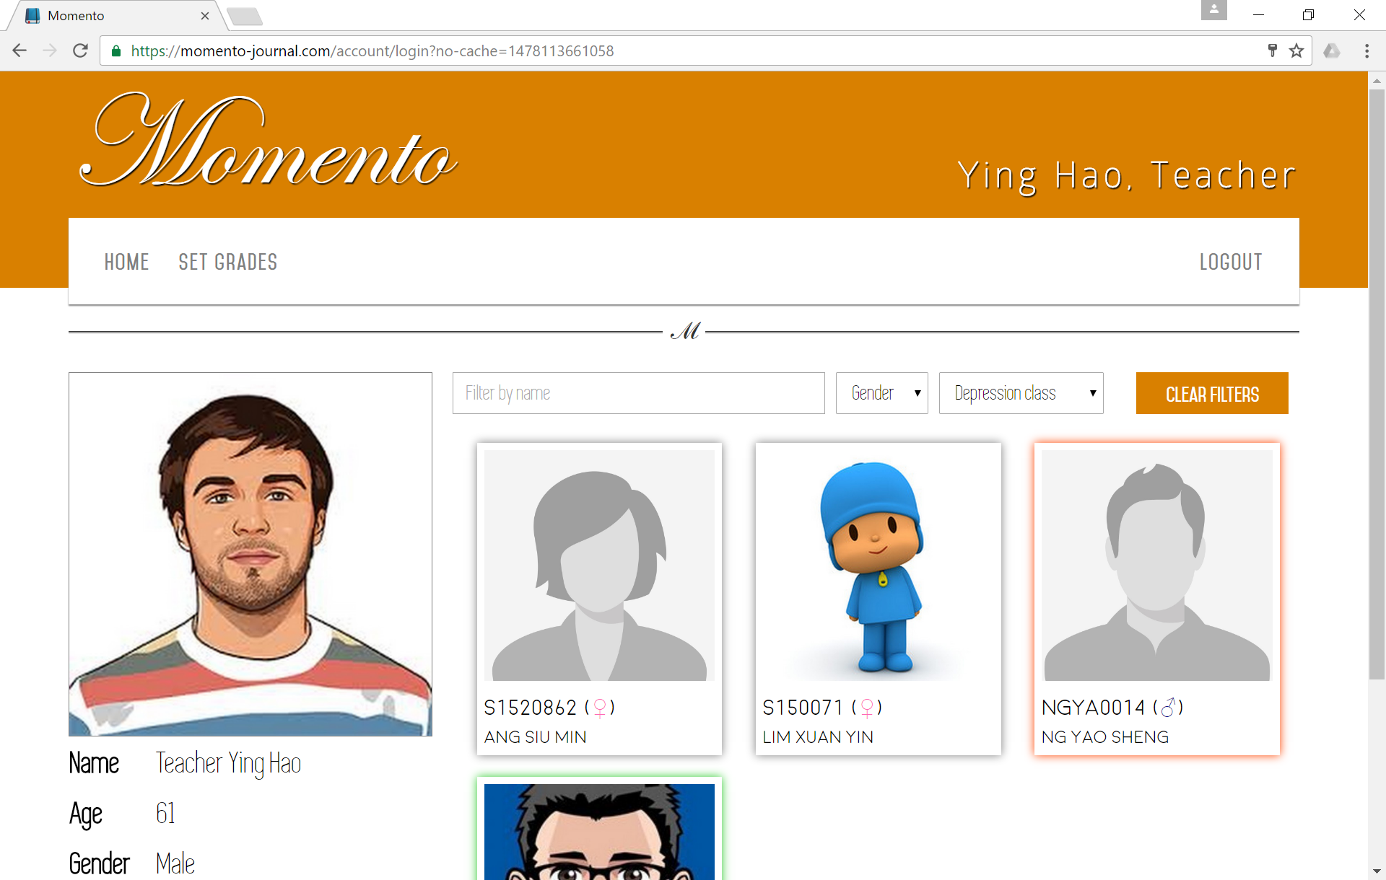
Momento
Journal
Software
detect depression amongst students

Slide 7
MOMENTO
Combines the power of machine learning with the students’ data feeds

Slide 8

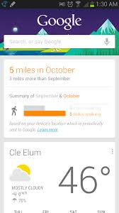

Machine learning
95% accuracy in classification problem
Evident in many areas in life

Slide 9
benefits
Potential early detection of depression
Prevent possible unfortunate incidents
Potential to save your loved ones

Slide 10
Last journal entry
Dear Friend,
I lost it. I just sort of keeled over and thought 'I can't do this'. Like, I've known that I will never have a dazzling life, what with the grades I get. But if I keep carrying on like this, I might actually end up snapping...
I don't know how I'm going to cope when I get back to school. Will it really help if I ask for it? Would I just be wasting my parents' money? But the whole point is that I can't ask for it anyway. How do you explain that you might have social anxiety... I just don't know. And it scares me.

Slide 11
Thank you

